Slide 2
R/W Images in MATLAB
So we have an image file… how do I access the info?
Open up MATLAB and change working directory to where image is stored
Use the imread() function
im = imread(‘name_of_image.ext’)
Use single quotes, and type in the full name of the image with its extension (.bmp, .jpg, etc.)
im will contain a 2D matrix (rows x cols) of B&W values or a 3D matrix (rows x cols x 3) of colour values
Matrix corresponds to each pixel in the digital image for B & W, or a colour component of a pixel in colour

Slide 3
R/W Images in MATLAB – (2)
How do I access a pixel in MATLAB → B&W case?
pix = im(row,col);
row & col: Row & column of the pixel to access
pix contains the intensity value
Access elements in an array by round braces, not square!
For you C buffs → Indexing starts at 1, not 0!
How do I access a pixel in MATLAB → Colour case?
pix = im(row,col,1); → Red colour value
pix = im(row,col,2); → Green colour value
pix = im(row,col,3); → Blue colour value
3rd argument → 3rd dimension of matrix
Only grabs one colour value at a time!

Slide 4
R/W Images in MATLAB – (3)
How can I get the RGB pixel entirely? Use the :
command
pix = im(row,col,:);
: means to grab all values of one dimension
However, this will give you a 1 x 1 x 3 matrix… we just want an array! Call the squeeze() command
pix = squeeze(im(row,col,:));
Now a 3 x 1 vector. To access R, G and B values, do:
red = pix(1) → Red, gr = pix(2) → Green,
blue = pix(3) → Blue

Slide 5
R/W Images in MATLAB – (4)
So I know how to get pixels; how can I modify them in the image?
Easy! Just go backwards
For a B & W Image do:
im(row,col) = pix;
For a colour image, do either: im(row,col,1) = red; im(row,col,2) = green; im(row,col,3) = blue; or
im(row,col,:) = [red; green; blue] or
im(row,col,:) = rgb; %rgb - 3 x 1 vector

Slide 6
R/W Images in MATLAB – (5)
How do I access a subset of the image?
 How do I grab a portion of the image and store it into another variable?
Do the following for monochromatic images:
im2 = im(row1:row2,col1:col2);
Do the following for colour images:
im2 = im(row1:row2,col1:col2,:);
This will grab a rectangular region between rows 1 and 2, and columns 1 and 2
e.g., if I wanted to get rows 17 – 31, and columns 32 – 45 for colour, do: im2 = im(17:31,32:45,:);

Slide 7
R/W Images in MATLAB – (6)
So I know how to get pixels; how can I display images?
Use the imshow() command
imshow(im); → im: Image loaded into MATLAB
Shows a new window with the image in it
If you do: imshow(im,[])
For monochromatic: Smallest intensity becomes 0 and largest intensity becomes 255 for display
For colour: Apply the above for each colour channel
Every time you use imshow, the image you want to display is put in the same window… so what do you do?

Slide 8
R/W Images in MATLAB – (7)
Use figure command to create a new blank window
Then, run the imshow command to display the image on the other window
We can also do:
imshow(im(:,:,1)); → Shows red channel
imshow(im(:,:,2)); → Shows green channel
imshow(im(:,:,3)); → Shows blue channel
(:,:,1) means grab all of the rows and columns for the first layer (i.e. red), etc.

Slide 9
R/W Images in MATLAB – (8)
When showing the red channel:
Darker pixels mean there isn’t much red in that pixel
Lighter pixels mean there is a lot of red in that pixel
Same applies for green and blue!
How do I save images to disk? Use imwrite()
imwrite(im, ‘name_of_image.ext’, ‘EXT’);
im → image to write to disk
name_of_image.ext → Name of the image
‘EXT’ → Extension of the file (‘JPG’, ‘BMP’, ‘PNG’, etc.)

Slide 10
Demo Time #1!
Reading in Images Accessing Pixels Changing Image Pixels Obtaining a Subset
Display Images → Monochromatic and Colour Displaying Colour Channels Separately
Writing Images to File

Slide 11
Topics Covered in this Presentation
 1st Hour: 6:10 p.m. – 7:00 p.m.
Introduction to Digital Images and in MATLAB
Quick intro to myself
What is MATLAB and where do I get it / find it?
Intro to Digital Images
Basic I/O → Reading and writing images
Accessing pixels and groups of pixels
Resizing Images
Rotating Images
…break for 10 minutes!

Slide 12
Resizing Images
One common thing that many people do is resize images
 i.e. Make an image bigger from a smaller image, or make an image smaller from a larger image
How do we resize images in MATLAB? Use the
imresize command → How do we use it?
out = imresize(im, scale, ‘method’); or
out = imresize(im, [r c], ‘method’);
 For both methods → im is the image we want to resize, and out is the resized image

Slide 13
Resizing Images – (2)
Let’s look at the first method:
out = imresize(im, scale, ‘method’);
scale takes each of the dimensions of the image (# of rows and columns), and multiplies by this much to determine the output
e.g. If we have an image that is 20 rows x 40 columns:
If scale = 2, the output → 40 rows x 80 columns
If scale = 0.5, the output → 10 rows x 20 columns
method determines the type of interpolation when resizing → Important when making an image bigger

Slide 14
Resizing Images – (3)
When we are making an image bigger, we are trying to create an image with a lack of information present
There are three main types of interpolation
Nearest Neighbour → method = ‘nearest’
Uses the best pixels that are near the original pixels and fills in missing information
Bilinear Interpolation → method = ‘bilinear’
Uses linear interpolation in 2D to fill in missing information
Bicubic Interpolation → method = ‘bicubic’
Uses cubic interpolation in 2D to fill in missing information
Usually, bicubic is known to have the best accuracy

Slide 15
Resizing Images – (4)
Now, let’s take a look at the second method for resizing
out = imresize(im, [r c], ‘method’);
This routine will resize the image to any desired dimensions you want
You can customize how many rows and columns the final image will have
Example: To resize a 130 rows x 180 columns image to 65 rows x 90 columns, with bilinear interpolation, do:
out = imresize(im, [65 90], ‘bilinear’);
We can also do!
out = imresize(im, 0.5, ‘bilinear’);

Slide 16
Rotating Images
Suppose we want to rotate an image → How?
out = imrotate(im, angle, ‘method’);
im: The image we want to rotate
angle: How much we want to rotate the image
 Angle is in degrees! Positive angle denotes counter- clockwise rotation, and negative angle is clockwise
When rotating, there will inevitably be some missing information → method is like before with resizing
out: The rotated image
Example: Let’s rotate CCW by 45 degrees by bilinear:
out = imrotate(im, 45, ‘bilinear’);

Slide 17
Demo Time #2!
Enlarging Images Shrinking Images Rotating Images

Slide 18
Topics Covered in this Presentation
 2nd Hour: 7:10 p.m. – 8:00 p.m. Operations on Digital Images
Simple contrast and brightness enhancing
Intro to image histograms
Advanced enhancing using image histograms
Intro to convolution in images
Blurring / Smoothing images
Edge detection
Sharpening images
…break for 10 minutes!

Slide 19
Cont. & Brig. Enhancement
First real application → Brightness enhancement
How do we increase /decrease brightness of an image?
1 way: Just add or subtract a brightness to every pixel
How? im2 = im + c; or
im2 = im – c; → c is any constant (0 – 255)
Takes c and add / subtract to every pixel in the image
Adding / subtracting makes the image brighter / darker
Round off occurs if out of range (i.e. set to 255 if > 255/set to 0 if < 0)
What about another way?
We can also scale the image by a constant
Do: im2 = c*im;
If c > 1, increasing brightness
If c < 1, decreasing brightness

Slide 20
Cont. & Brig. Enhancement (2)
So we covered brightness… what about contrast?
Contrast → How well you can see the objects from the background
When performing brightness enhancing, you’ll notice that it looks “white washed out” → Poor contrast
We can do a contrast enhancement to make objects look better, leaving background relatively unaffected
How? Use the power law → s = r^{γ}
 r is the input pixel intensity / colour and s is the output intensity / colour

Slide 21
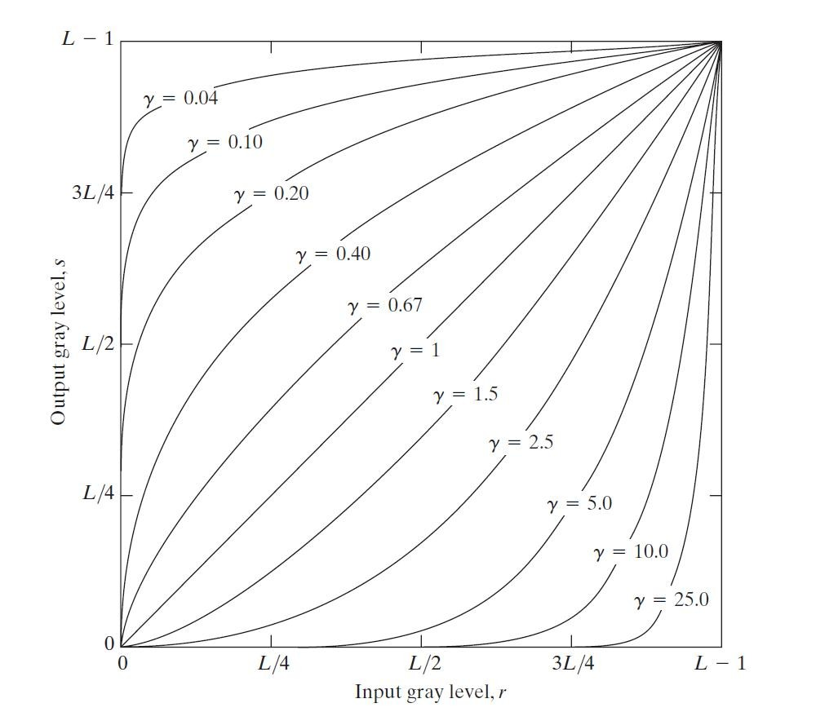
Cont. & Brig. Enhancement (3)
For each pixel, apply this equation to each of the intensities / colours
For colour images, apply to each channel separately
Exponent γ determines how dark or light the output is
γ > 1 → Make darker
γ < 1 → Make lighter

Slide 22
Cont. & Brig. Enhancement (4)
How do we apply the power law in MATLAB?
 Use imadjust
out = imadjust(im, [], [], gamma);
im: Input image to contrast adjust
Ignore 2nd and 3rd parameters → Beyond the scope of our talk
gamma: The γ exponent that we’ve seen earlier
out: The contrast adjusted image
Example use: If γ = 1.4, we do:
out = imadjust(im, [], [], 1.4);

Slide 23
Demo Time #3!
Contrast and Brightness Enhancement

Slide 24
Topics Covered in this Presentation
 2nd Hour: 7:10 p.m. – 8:00 p.m. Operations on Digital Images
Simple contrast and brightness enhancing
Intro to image histograms
Advanced enhancing using image histograms
Intro to convolution in images
Blurring / Smoothing images
Edge detection
Sharpening images
…break for 10 minutes!

Slide 25
Intro to Image Histograms
We can perform more advanced image enhancement using histograms
Before we cover this… we should probably cover what histograms are! So, what’s a histogram?
It measures the frequency, or how often, something occurs
Let’s look at a grayscale image for now
Expressed as H(x) = q, x is an intensity- [0,255] for 8 bits
This tells us that we see the intensity value of x for a total of q times

Slide 26
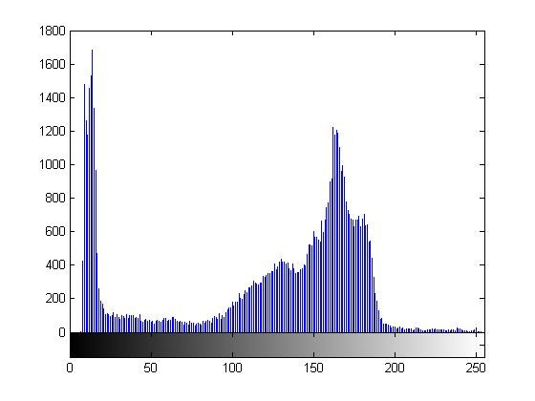
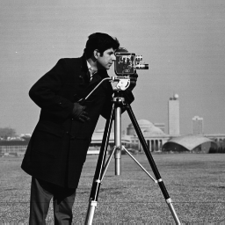
Intro to Image Histograms – (2)
 Example: Let’s take a look at an grayscale image
There are ~1500 pixels with a gray level of around 10
There are ~1200 pixels with a gray of around 170, etc.

Slide 27
Intro to Image Histograms – (3)
How do we create histograms in MATLAB?
imhist(im); %im is read in by imread
Assuming im is a grayscale image
If we want this to work with colour images, we will have to display the histogram of each colour channel by itself
 imhist(im(:,:,1)); | % | histogram | for | red
 imhist(im(:,:,2)); | % | histogram | for | green
 imhist(im(:,:,3)); | % | histogram | for | blue
 The (:,:,1) means that we should grab every row and column from the red channel, etc.

Slide 28
Intro to Image Histograms – (4)
Grabbing all of the pixels in any channel will produce a grayscale image, which can be used for imhist
We can also call the histogram function by:
h = imhist(im);
Will create a 256 element array, where the (i+1)’th element contains how often we see the grayscale i.
Histograms give us a good insight on image contrast
If the histogram has too many values towards the left
→ Image is too dark
If the histogram has too many values towards the right
→ Image is too bright
If the histogram has too many values in the middle
→ Image looks very washed out

Slide 29
Advanced Enhancement – (1)
Above cases are when the image has bad contrast
A good image should have good contrast
i.e. The histogram should have an equal number of pixels over the entire histogram (a flat histogram)
If an image has bad contrast, we can try to correct it by doing histogram equalization
Tries to make the image’s histogram as flat as possible for good contrast → Stretches the histogram out
For you probability nerds → If you divide each histogram entry by the total number of entries, this forms a Probability Density Function (PDF)

Slide 30
Advanced Enhancement – (2)
 Histogram equalization seeks to modify the PDF so that all possible events (pixels) are equally likely to occur
How do we perform histogram equalization?
out = histeq(im); %im given by imread
What about for colour images?
 You will have to perform histogram equalization on each channel individually, then merge together
r = im(:,:,1); g = im(:,:,2); b = im(:,:,3);
out(:,:,1) | = | histeq(r);
out(:,:,2) | = | histeq(g);
out(:,:,3) | = | histeq(b);

